Slide 1


micro:bit entry video tutorial
Lesson 21
micro:bit creative lesson 21 Target score
YahBoom micro:bit creative tutorial

Slide 2
micro:bit entry video tutorial
Content
Part1
Part 2
Part 3
Part 4
Learning goals
Preparation
Search for blocks
Combine blocks
YahBoom micro:bit creative tutorial

Slide 3
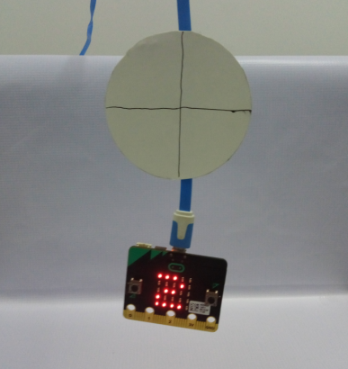
micro:bit entry video tutorial
Part 1
Learning
goals
After you download the program，you can use a piece of cardboard as a target on the cable. You can use ping-pang ball as a throwing dart. Whenever you hit it, the scorer will add one point. If you don't hit it, you won't score.
YahBoom micro:bit creative tutorial

Slide 4
micro:bit entry video tutorial
Part 2
Hardware:
● 1 x Micro:bit Board
● 1 x USB Cable
● 1 x cardboard
● 2 x ping-pang Ball
Preparation
Then the micro:bit is connected to the computer through USB,
and the computer will pop up a U disk and click the URL in the U disk
to enter the programming interface.Input this URL
https://github.com/lzty634158/yahboom_mbit_en to get the package.
YahBoom micro:bit creative tutorial

Slide 5
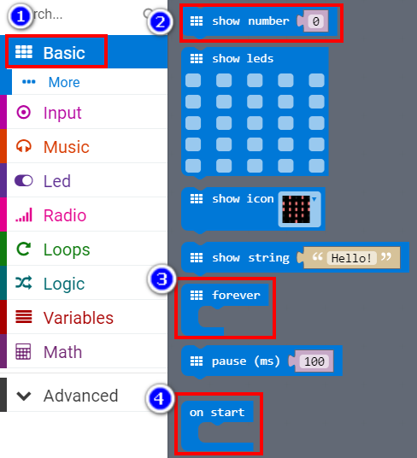
micro:bit entry video tutorial
Part 3
Search for
blocks
YahBoom micro:bit creative tutorial

Slide 6
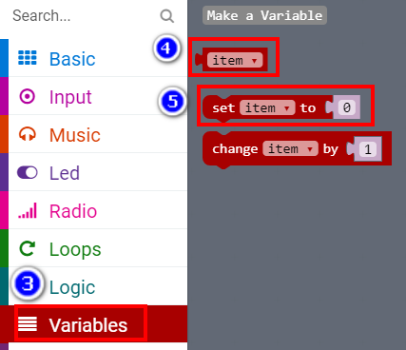
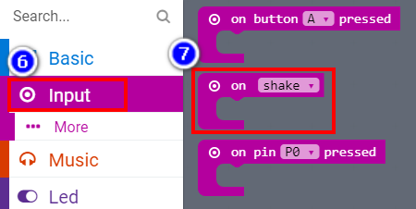
micro:bit entry video tutorial
Part 3
Search for
blocks
YahBoom micro:bit creative tutorial

Slide 7
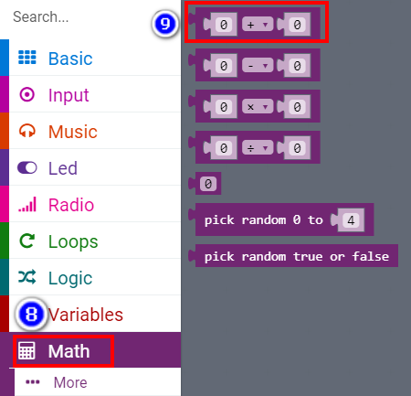
micro:bit entry video tutorial
Part 3
Search for
blocks
YahBoom micro:bit creative tutorial

Slide 8
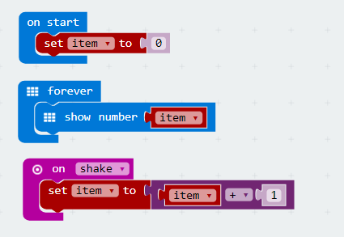
micro:bit entry video tutorial
Part 4
Combine
blocks
YahBoom micro:bit creative tutorial

Slide 9
micro:bit entry video tutorial
micro:bit
project
Thanks for watching!
Powered by
YahBoom
YahBoom micro:bit creative tutorial

